Slide 1
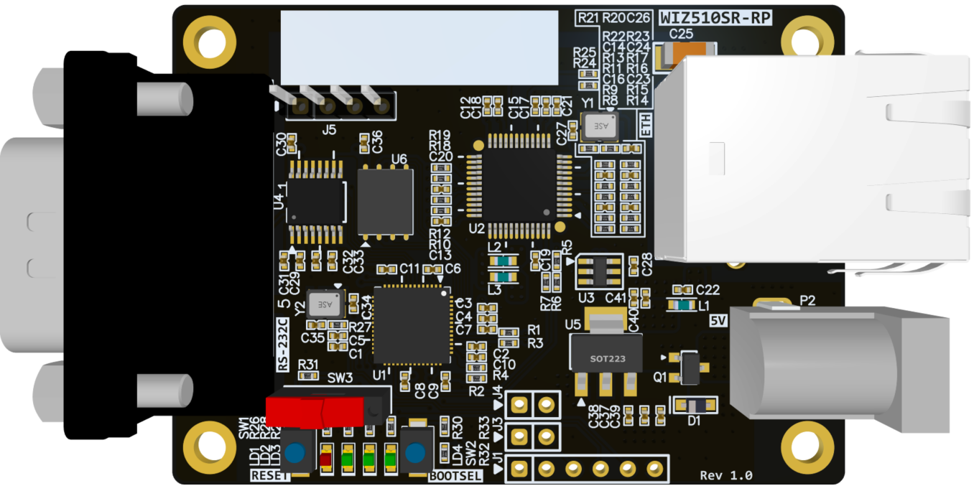
WIZ510SR-RP 3D(TOP)

Slide 2
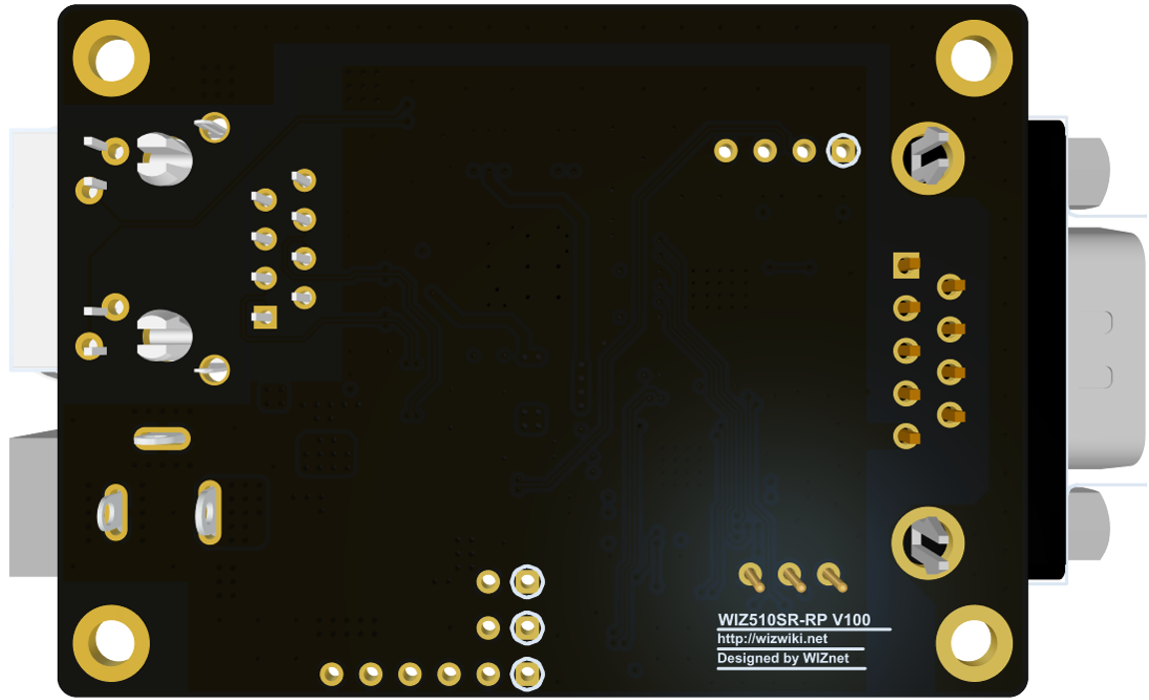
WIZ510SR-RP 3D(BOT)

Slide 3
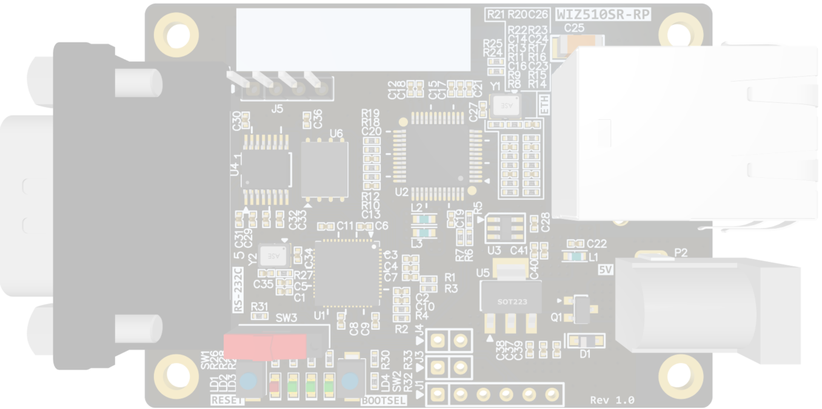
WIZ510SR-RP Callout Top
J5
DP/DM Header
U6
Flash Memory
U2
W5100S
U4
RS232 IC
J4
FACT RST
(Not Mount)
U1
RP2040
J3
BOOT MODE
(Not Mount)
SW3
HW TRIG
SW1
RESET
J1
DEBUG
(Not Mount)
LD1~4
Indicade LED
SW2
BOOTSEL

Slide 4
WIZ510SR-RP Callout BOT
WIZ510SR-RP 은 bot 실장이 없어서 WIZ510SR-RP 3D(TOP)으로 대체

Slide 5
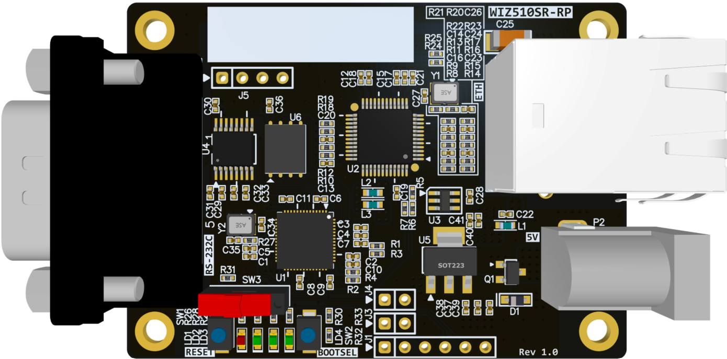
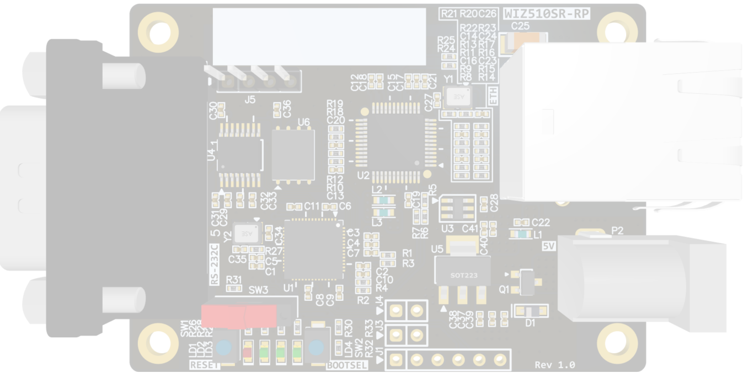
J5
J5
3V3
USB DP
J4
USB DM
FACT RST
GND
GND
J3
BOOT MODE
GND
J1
3V3
UART0 TX
UART0 RX
SWCLK
SWDIO
GND
WIZ510SR-RP Pinout

Slide 6
LD4
LD3
LD2
LD1
WIZ510SR-RP LED

Slide 7
J1
3V3
UART0 TX
UART0 RX
SWCLK
SWDIO
GND
WIZ510SR-RP (J1-Pinmap)

Slide 8
P1
RJ45 Jack
WIZ510SR-RP (P1)

Slide 9
J2
DB9M
WIZ510SR-RP (J2-Pinmap)

Slide 10
P2
DC Jack
WIZ510SR-RP (J2-Pinmap)

Slide 11
J3
BOOT MODE
GND
WIZ510SR-RP (J3-Pinmap)

Slide 12
J4
FACT RST
GND
WIZ510SR-RP (J4-Pinmap)

Slide 13
J5
J5
3V3
USB DP
USB DM
GND
WIZ510SR-RP (J5-Pinmap)

Slide 14
SW1
RESET
WIZ510SR-RP RESET

Slide 15
SW2
BOOTSEL
WIZ510SR-RP BOOTSEL

Slide 16
SW3
HW TRIG
WIZ510SR-RP HW TRIG

Slide 17
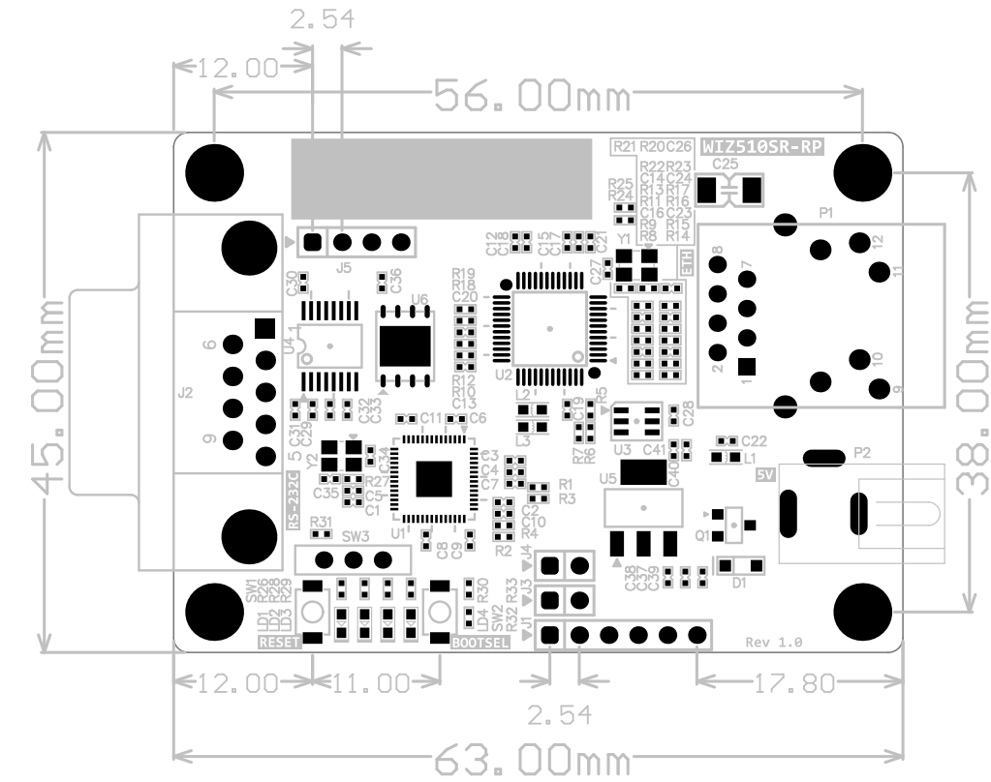
WIZ510SR-RP PCB TOP

Slide 18
WIZ510SR-RP PCB BOT은
Bottom면에 실장되는 커넥터가 없어 생략

